Slide 1



What counts as AI?
AI in Assessment: Helping Hand or Pandora's Box?
Nathan Thompson, PhD
CEO
Assessment Systems

Slide 2


Introduction

Slide 3



Introduction

Slide 4
Why AI?
Helps us address some pain points in assessment
Reduce item writing time/costs
Develop better items
Review items
Assemble linear forms
Make the tests smarter and faster for examinees
Reduce essay marking time/costs
Maintain security in delivery

Slide 5
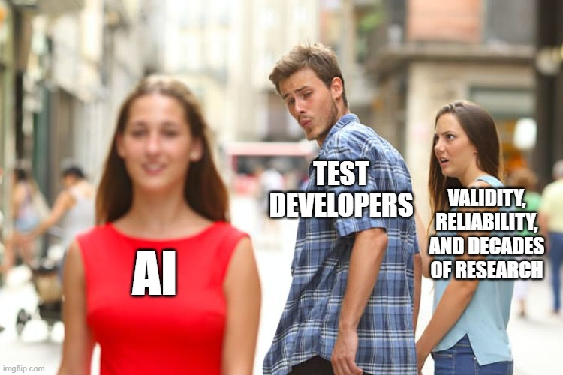
Why AI?
But…

Slide 6
Why AI?
So, will it help us solve our pain points?
Or, will it lead to new problems?
What constraints are needed?
The answer, in many cases: it has been providing solutions, for decades.
Also, LLMs are new… how do we evaluate them?

Slide 7
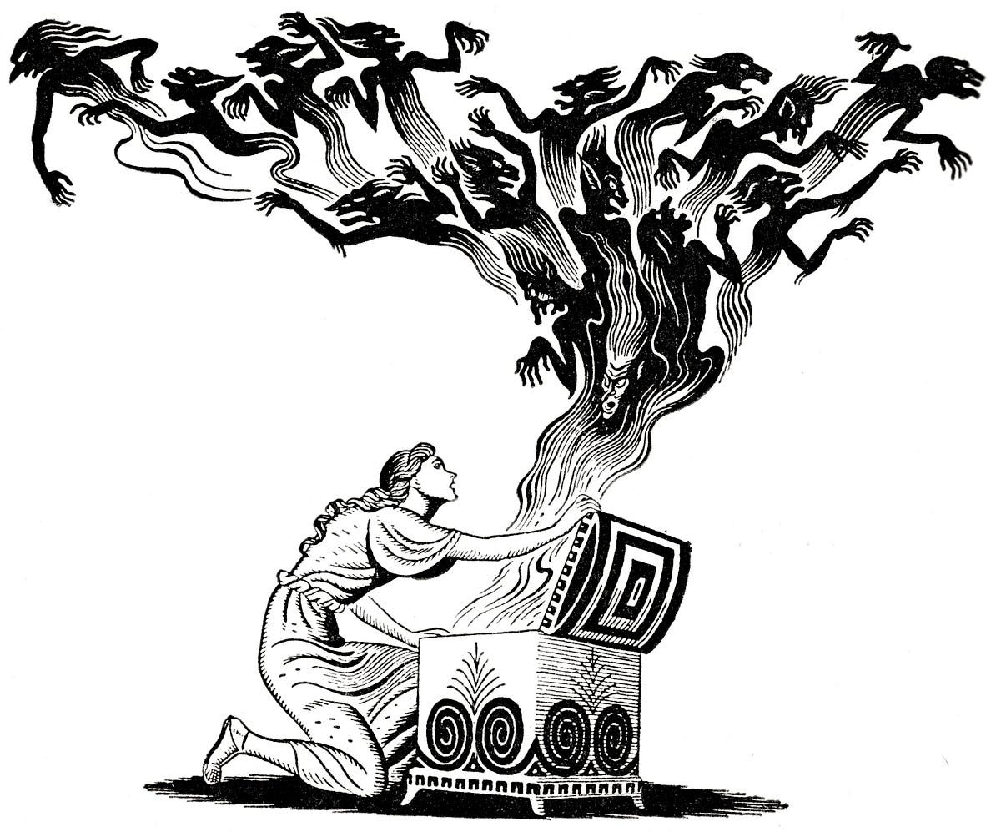

Why AI?
More trouble than it is worth
Pandora’s box
Helping Hand
Panacea /
Silver Bullet

Slide 8




What is AI?
Also… NOT JUST CHATGPT!

Slide 9
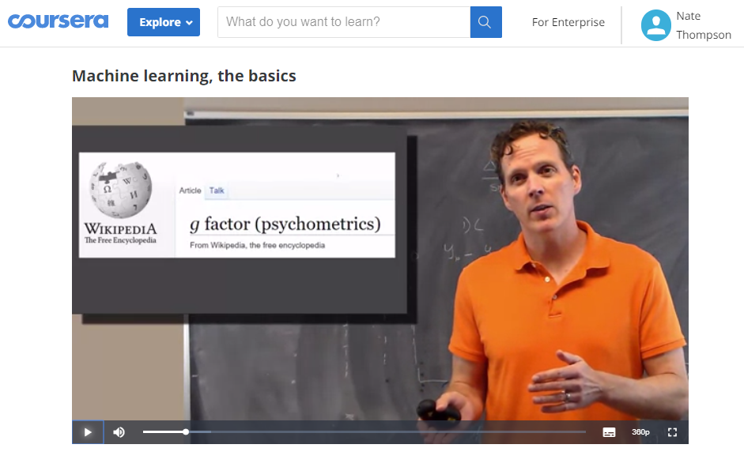
New terms, not new ideas!

Slide 10

Part 2
AI and ML:
An Introduction

Slide 11
Definitions
Machine Learning
The use and development of computer systems that are able to learn and adapt without following explicit instructions, by using algorithms and statistical models to analyze and draw inferences from patterns in data. (Oxford)
Artificial Intelligence
The theory and development of computer systems able to perform tasks that normally require human intelligence, such as visual perception, speech recognition, decision-making, and translation between languages. (Oxford)

Slide 12

Definitions
Machine Learning: Unsupervised
Looking for patterns with no particular goal
Machine Learning: Supervised
Some sort of goal in mind (label/criterion/prediction)

Slide 13
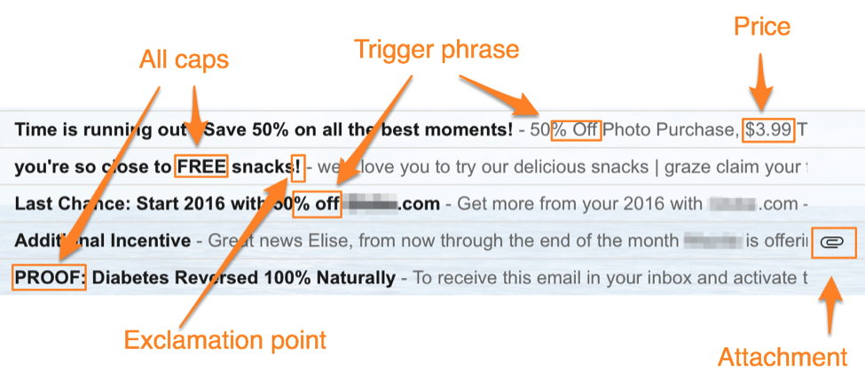
Machine learning & AI
Common example is logistic model to predict binary outcome...
“Natural language processing”
Here’s one that we all use every day!
Can we apply it to assessment…?

Slide 14
Part 3
AI and ML in Assessment and Psychometrics

Slide 15
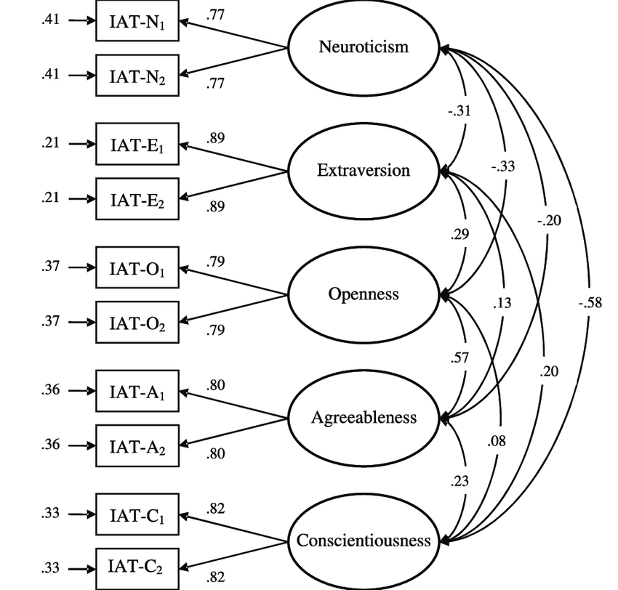
ML: Factor Analysis
Evaluate dimensionality, find patterns (unsupervised ML)
3 levels: Items, subscores, tests/battery
Invented in 1904!!!!!!!!!
Schmukle, Back, & Eglogg (2008)

Slide 16
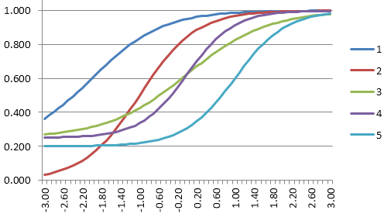
ML: Item Response Theory (IRT)
Fits logistical models to find patterns and make sense of the data (unsupervised ML)

Slide 17
ML: Cognitive Diagnostic Models (CDMs)
Make a “Q matrix” for items and curriculum/blueprint
Can be supervised or unsupervised
Item | Excel Formulas | Quant reasoning | Tax knowledge | Reports
1 | 1 | 0 | 0 | 1
2 | 0 | 0 | 1 | 1
3 | 0 | 0 | 1 | 0
4 | 1 | 0 | 0 | 0
5 | 0 | 1 | 1 | 0

Slide 18
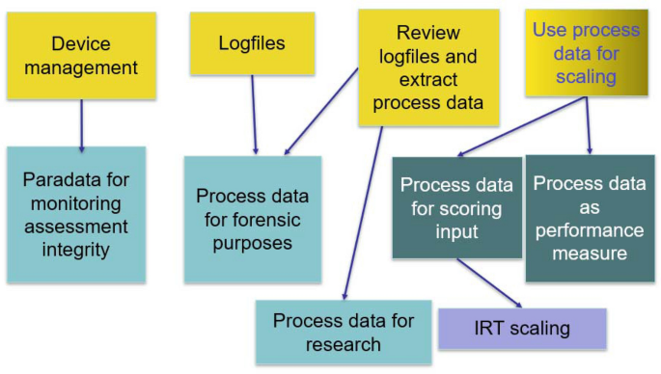
ML: Process Data
Let’s use ALL the data we have from assessment and learning
We need complex ML to make sense of it
Provasnik (2021)

Slide 19
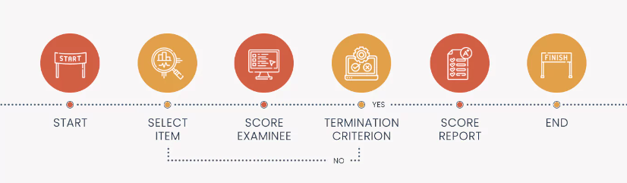
AI: Computerized Adaptive Testing (CAT)
Uses IRT to personalize the test for all examinees
Reduces time by 50%, more secure, can measure off-grade, and more
Automates Alfred Binet’s 1908 IQ test with ML

Slide 20
AI: Automated essay scoring (AES)
NLP does not mean we are naturally processing
We train a machine learning model for each prompt/rubric
AI can now also do evaluation and feedback
Score | school_board | three_reasons | leadership | ludacris
5 | 3 | 1 | 2 | 0
4 | 2 | 1 | 0 | 0
3 | 1 | 1 | 1 | 0
2 | 2 | 0 | 0 | 0
1 | 0 | 0 | 0 | 2

Slide 21
AI: Automated essay scoring (AES)
Here are some results from US high school equivalency exam
R or Python with basic NLP/ML: 0.65 – 0.80
LLAMA-3 without fine-tuning: 0.18
LLAMA-3 with fine-tuning (long run time with high costs): 0.81

Slide 22
AI: Automated essay scoring (AES)
Funny thing is, every website inquiry I have received thinks that #2 above is the only approach, and that it is a panacea
They also think that:
No humans need to mark anything
We don’t even need to establish rubrics, the AI will just “figure out what growth mindset means”

Slide 23
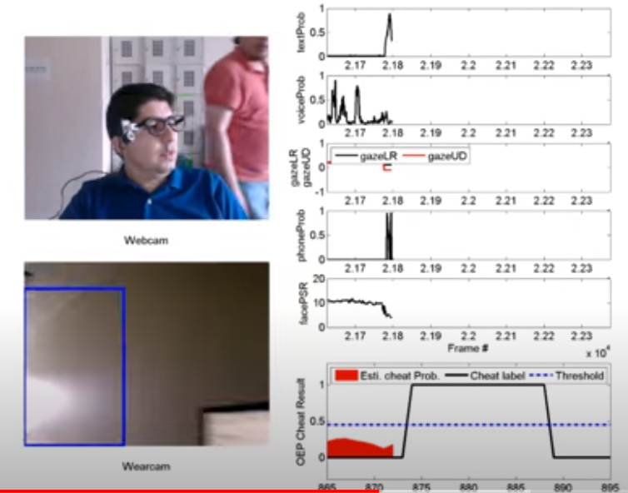
AI: Remote Proctoring
Break it down into solvable problems
Looks for checklist of issues by evaluating still images based on ML models

Slide 24
ML/AI outside the Assessment
Prediction models:
Job performance, counterproductive work behavior, tenure
Same for Universities too!
Resume/CV evaluation
Adaptive learning
CrystalKnows, Cambridge Analytica, etc
So much more!

Slide 25
Part 3
LLMs

Slide 26
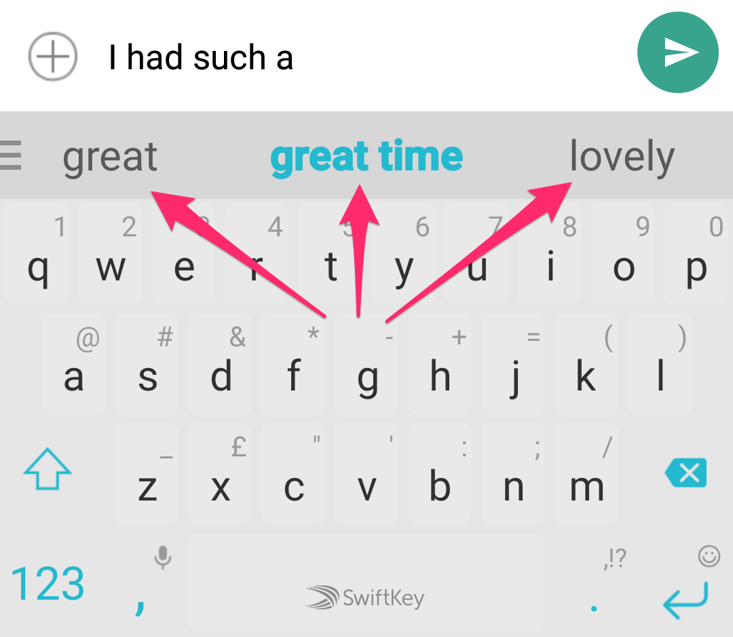
Intro to LLMs
LLMs are massive ML models
Sort of like essay scoring in that they break down texts into a regression-type data set
Predict the next word or words based on prompts and previous words

Slide 27


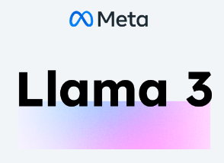

Intro to LLMs

Slide 28
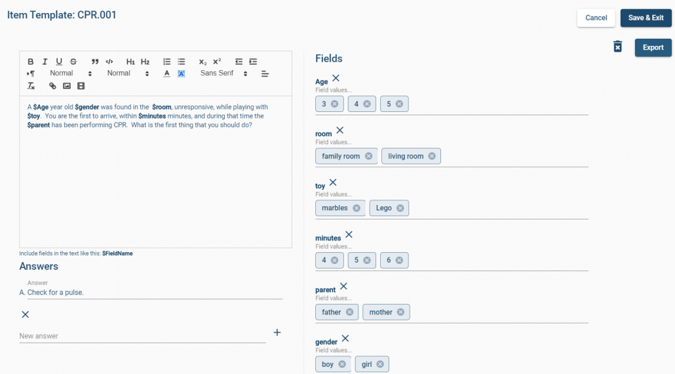
AI: Automated item generation (AIG)
Early attempt: templates
This can still be 6x as effective (Medical Council of Canada)

Slide 29
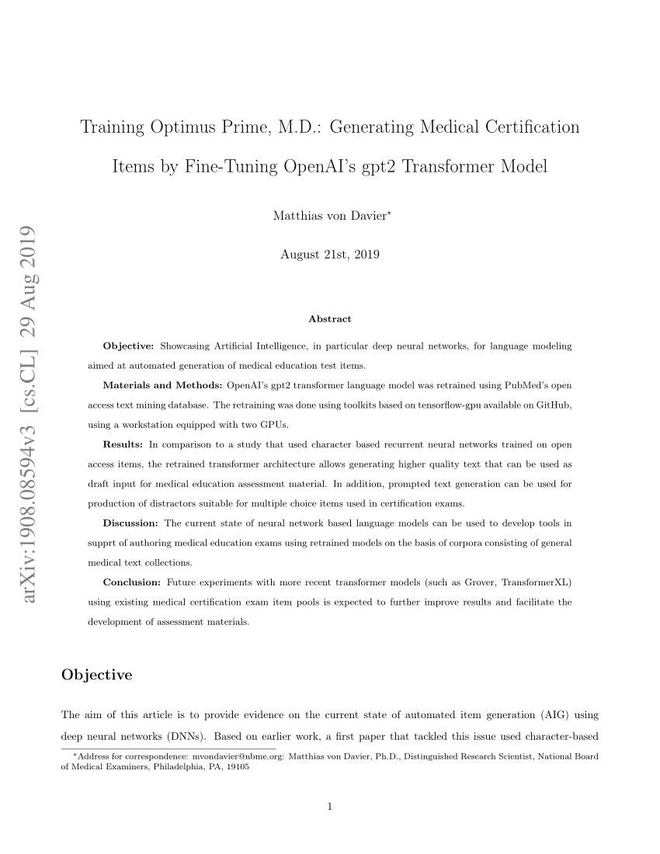
AIG
We’ve all heard about ChatGPT, but what does it mean for assessment?

Slide 30
AIG
Classic comparison also used for AES: how does ChatGPT compare to human quality?
Jones, Becker, & Ferris (2023)

Slide 31
Item Review
First: code your rules into your item banker
Second: LLMs?
Ask LLM to review
Provide your review criteria to LLM
Fine-tune LLM based on past reviews

Slide 32
Item Review
Item Writing Rules
1. No colon at the end of the question stem.
2. Do not repeat text in the answers.
Question 1
The capital of South Korea is:
A. Seoul
B. Tokyo
C. London
D. Paris
Question 2
What is 2 + 2?
A. The answer is 4.
B. The answer is 6.
C. The answer is 8.
D. The answer is 10.

Slide 33
Item Review
Here’s the feedback based on your rules:
Question 1
Rule 1: Violates the rule about not using a colon at the end of the question stem.
Rule 2: This question follows the rule, as the answers don’t repeat text.
Question 2
Rule 1: This question adheres to the formatting rule (no colon).
Rule 2: Violates the rule, as all answers repeat “The answer is.”
Suggested Revisions:
Question 1
The capital of South Korea is
A. Seoul
B. Tokyo
C. London
D. Paris
Question 2
What is 2 + 2?
A. 4
B. 6
C. 8
D. 10
Let me know if you need further assistance!

Slide 34
Part 3
Recommendations and Future

Slide 35
Using AI
We have been using ML and AI in psychometrics for more than a century!
Most of it is highly specific, developed to meet certain needs
Not a panacea, but very powerful in the right hands
E.g., IRT revolutionized a lot of tricky problems

Slide 36
Using LLMs
They are being used more and more
Very powerful, but not a panacea
Huge time saver but still needs humans
Consider the results from Jones et al. – better results than human writers, but tons of items still need editing

Slide 37
Thoughts on AES
Being able to explain and support the model is very important… that is validity!
Using LLMs might have the same accuracy, but is a total black box; a lawsuit waiting to happen
Especially true without fine-tuning, which also means that no humans have rated any students

Slide 38

Security?
Do you want to feed your content to an LLM to make items?
Past items
Your textbooks etc.
How about data from past item reviews or item statistics?
For AES, how about all your student essays and human marks?
Public vs self-hosted

Slide 39

The future?
As in many other areas, LLMs and other AI are making an impact
Even if they only provide 10% improvement, you do not want to be left behind
It is irresponsible to avoid AI altogether
Friend that was told to stop all AI, even spam filters!
So you need to decide what to use, and with what guardrails and post hoc checks

Slide 40

The future?
AI

Slide 41




Questions?
nate@assess.com

